Slide 1

PYASSIST – MULTI CRITERIA DECISION MAKING
THE NEW WAY OF MAKING CHOICES

Slide 2

INTRODUCTION
This project aims to develop a comprehensive solution for trip planning using advanced algorithms and web technologies. The system leverages multi-criteria decision-making (MCDM) techniques to help users select the best places to visit from a list of options.

Slide 3

PROBLEM STATEMENT
Users often face the challenge of selecting the best places to visit from a large pool of options, which can be time-consuming and costly. This project aims to address this issue by implementing a decision-making framework that uses Multi-Criteria Decision-Making (MCDM) algorithms. By evaluating various criteria, the framework will help users identify the most suitable places to visit, thereby saving time and reducing costs. This solution ensures efficient and effective decision-making, enhancing the user's overall experience and resource management

Slide 4
EVOLUTION OF MULTI-CRITERIA DECISION ANALYSIS
1772
1950
1970
2010
The earliest known reference relating to Multiple Criteria Decision Making can be traced to Benjamin Franklin (1706 1790), who allegedly had a simple paper system for deciding important issues.
Researchers in the 1950s began to formalize decision-making processes mathematically. This era marked the beginning of structured approaches to tackle complex decision problems involving multiple criteria
Introduction of methods like Analytical Hierarchy Process(AHP) and TOPSIS was a major break in the history of MCDM.
Integration with machine learning techniques allowed for the automation and improvement of decision-making processes, enhancing the predictive capabilities of MCDM models.

Slide 5
RELATED WORK
Recent studies have focused on integrating MCDM with other decision-making tools and technologies, such as:
Fuzzy Logic: Incorporating fuzzy sets to handle uncertainty and imprecision in decision-making.
Artificial Intelligence: Using machine learning algorithms to enhance the accuracy and efficiency of MCDM methods.
Big Data Analytics: Leveraging large datasets to provide more comprehensive and data-driven decision support.

Slide 6

MCDM ALGORITHMS
Multi-Criteria Decision Making (MCDM) encompasses a variety of algorithms designed to evaluate and prioritize options based on multiple criteria. Key methods include the Analytic Hierarchy Process (AHP), the Technique for Order Preference by Similarity to Ideal Solution (TOPSIS), the Simple Additive Weighting (SAW) method, and the Preference Ranking Organization Method for Enrichment Evaluation (PROMETHEE). The overall importance of MCDM lies in its ability to provide systematic, transparent, and objective frameworks for complex decision-making processes across various fields, ultimately leading to more informed and balanced decisions.

Slide 7

WEIGHTED SUM METHOD
Simple Additive Weighting (SAW) is a widely used multi-criteria decision-making (MCDM) method that evaluates and ranks alternatives based on their overall performance across multiple criteria.
Each criterion is assigned a weight according to its importance, and the performance of each alternative is rated against these criteria.
The method involves normalizing the decision matrix to ensure comparability of different units, followed by multiplying the normalized scores by their respective weights.
The weighted scores for each criterion are then summed to obtain a total score for each alternative.
The alternative with the highest total score is considered the best option.

Slide 8

TOPSIS
The Technique for Order of Preference by Similarity to Ideal Solution (TOPSIS) is a multi-criteria decision-making (MCDM) method that ranks alternatives based on their closeness to an ideal solution.
Developed by Hwang and Yoon in 1981, TOPSIS assumes that the best alternative has the shortest distance from an ideal solution and the farthest distance from a nadir (worst) solution.
The method involves normalizing the decision matrix, calculating the weighted normalized decision matrix, determining the ideal and nadir solutions, and computing the Euclidean distance of each alternative from these solutions.
Finally, a relative closeness coefficient is calculated to rank the alternatives.

Slide 9

PROMETHEE
The Preference Ranking Organization Method for Enrichment Evaluations (PROMETHEE) is a sophisticated multi-criteria decision-making (MCDM) technique designed to rank a set of alternatives based on multiple, often conflicting criteria.
PROMETHEE compares each pair of alternatives to determine preferences through a preference function that reflects the decision-maker's attitude towards the differences in criteria values.

Slide 10

ANALYTICAL HIERARCHY PROCESS
The Analytic Hierarchy Process (AHP) is a structured multi-criteria decision-making (MCDM) technique.
AHP helps decision-makers set priorities and make decisions by breaking down a complex problem into a hierarchy of more easily comprehended sub-problems, each of which can be analyzed independently.
The process involves three main steps: decomposition, comparative judgment, and synthesis of priorities. In the decomposition step, the decision problem is structured into a hierarchy.
During comparative judgment, decision-makers perform pairwise comparisons of the elements at each level of the hierarchy, using a scale of relative importance.
Finally, in the synthesis step, the weights are aggregated to determine the overall ranking of the alternatives.

Slide 11
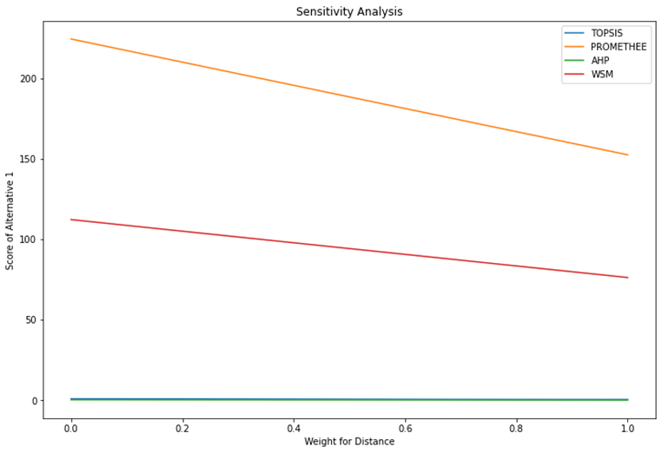
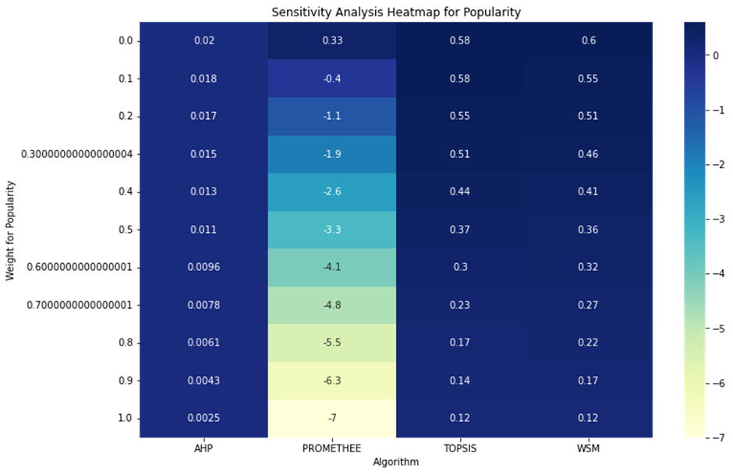
RESULT DISCUSSION
The eventual output is a comparison of different algorithms we used in multi-criteria Decision-Making. This can help in selection of an alternative either optimally or according to the user’s needs. The weight changes reflect the alternatives’ score according to a given algorithm given the same data. One of the only metrics to compare in case of multi-criteria Decision-Making is sensitivity analysis. Sensitivity analysis involves varying these weights to see how changes affect the overall rankings or decisions. This helps in understanding the robustness of the decision-making process to changes in weights.

Slide 12
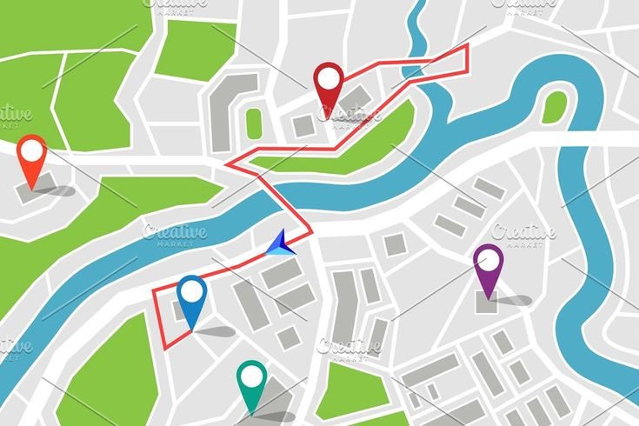
VISUAL OUTCOME AND CONCLUSION
01.
The visual outcome of this project is a folium map representing one of the applications of this Multi-criteria decision-making. Folium maps plot and locate the chosen places and connecting them to each other.
The decision making in the context of places of Interest(POI) utilizing Places API is a going above and beyond initiate to further the importance of MCDM. This helps in visualization and can serve to incorporate in a MCDM application in the future.
02.
The evolution of MCDM has significantly impacted various fields by providing structured, and comprehensive decision-making frameworks. Continued research and integration with emerging technologies promise to further enhance the applicability and effectiveness of MCDM methods.
03.

Slide 13

FUTURE SCOPE
In the future, integrating Multi-Criteria Decision Making (MCDM) with Python can revolutionize app development, providing personalized decision support to users based on their specific filters and preferences. By leveraging Python's robust libraries and frameworks, developers can create applications that dynamically evaluate various criteria to offer the best options for users. Furthermore, incorporating real-time data from APIs can enhance the accuracy and relevance of the suggestions. Python's versatility allows for seamless integration with various data sources, enabling apps to adapt to changing user requirements and environmental factors. This approach can be applied across various domains, such as travel planning, restaurant selection, and shopping, ultimately saving users time and effort while making informed decisions.

Slide 14

PRACTICAL APPLICATIONS
Multi-Criteria Decision Making (MCDM) is currently utilized in various practical and impactful ways. In healthcare, MCDM assists in choosing the most appropriate treatment plans by evaluating multiple factors like patient health conditions, treatment efficacy, and associated costs. In finance, it aids in making investment decisions by considering criteria such as risk, return, and market volatility, thus helping create balanced portfolios. Urban planning and development leverage MCDM to assess different projects based on sustainability, economic impact, and community benefits, ensuring that chosen projects provide the maximum overall benefit. Supply chain management uses MCDM to select suppliers and allocate resources efficiently, balancing cost, quality, and delivery performance.

Slide 15

PRESENTED BY OMAR YUSUF
THANK YOU VERY MUCH!

